Slide 1
C MINI PROJECT TICKET RESERVATION SYSTEM
SUBMITTED BY:
N.G.R. ABITHA(21CSE064)
N.AFFRIN FOWMIYA(21CSE065)
C.NANDHINI(21CSE077)
S.SWETHA(21CSE091)
GUIDED BY:
MR.G.BALAMURALIKRISHNAN
ASSISTANT PROFESSOR
DEPARTMENT OF COMPUTER SCIENCE
VELAMMAL COLLEGE OF ENGINEERING AND TECHNOLOGY

Slide 2
ABSTRACT
FOR JOURNEY OF LONGER DISTANCE ,THOUGH WE HAVE AIRWAYS MOST OF THE PEOPLE USE THE RAILWAYS, WHICH IS MOST CONVINIENT,AFFORDABLE MEANS OF TRANSPORT IN INDIA.
SO KEEPING THIS IN VIEW,THIS PROGRAM ENABLES US TO CHOOSE THE TRAIN THROUGH ONLINE BOOKING SO THAT THERE IS NO NECESSARY TO FILL A FORM AT THE COUNTER,I.E WE CAN DIRECTLY SELECT FROM THE CHOICES PROVIDED FOR US WITH TRAIN NUMBERS,TRAVEL CLASSES,NO. OF TICKETS,AND CHECKING AVAILABILITY.

Slide 3
CONCEPTS INVOLVED
STRUCTURE – Struct s
Functions-booking availability , cancellation, and main function
array- name[]
Control structure-switch , if() - else

Slide 4
LOGIC EXPLANATION
WE HAVE DIVIDED THIS PROGRAM INTO THREE MODULES BASED ON TICKET RESERVATION SYSTEM
THE THREE PROCESSES INVOLVED IN TICKET RESERVATION SYSTEM:
BOOKING
CHECKING AVAILABILITY OF TICKET
CANCELLATION TICKET

Slide 5
BOOKING
IN BOOKING PROCESS WE HAVE USED STRUCTURE
CONCEPT.THE NAME OF THE STRUCTURE IS NODE AND THE VARIABLE USED HERE IS “S”.
INSIDE THE STRUCTURE WE ARE GETTING NAME,NUMBER OF TICKETS NEEDED FOR THE PASSENGER,AGE, AND ALSO AADHAR NUMBER FROM THE USER.

Slide 6
CHECKING AVAILABLITY OF TICKETS
FOR CHECKING AVAILABILITY OF TICKETS ,WE HAVE USED THE CONCEPT SWITCH CASE.
THERE ARE 3 CASES INVOLVED HERE:
CASE(1) CHECKS THE AVAILABILITY OF FIRST CLASS TICKETS
IF TICKETS ARE AVAILABLE THE COST OF FIRST CLASS TICKETS ARE CALCULATED
CASE(2) CHECKS THE AVAILABLITY OF SECOND CLASS TICKETS
IF TICKETS ARE AVAILABLE THE COST OF SECOND CLASS TICKETS ARE CALCULATED
CASE(3) CHECKS THE AVAILABILITY OF THIRD CLASS TICKETS
IF TICKETS ARE AVAILABLE THE COST OF THIRD CLASS TICKETS ARE CALCULATED

Slide 7
CANCELLATION
IN CANCELLATION WE HAVE IMPLEMENTED IF-ELSE STATEMENTS.
SO FIRST THE CODE VERIFIES WHETHER WE HAVE BOOKED THE TICKET
AND WE HAVE INCLUDED A CONDITION FOR CANCELLING THE TICKET,I.E IF THE USER PRESSES “1” THE TICKET GETS CANCELLED
IN CASE IF THE USER HAS NOT BOOKED ANY TICKET,THE CODE EXITS AND IT WON’T ENTER THE IF-ELSE PART OF STATEMENTS ITSELF.

Slide 8
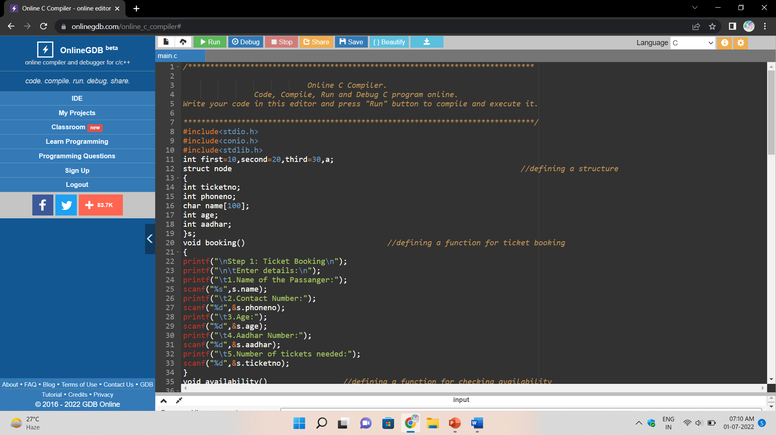
Code and
output:

Slide 9
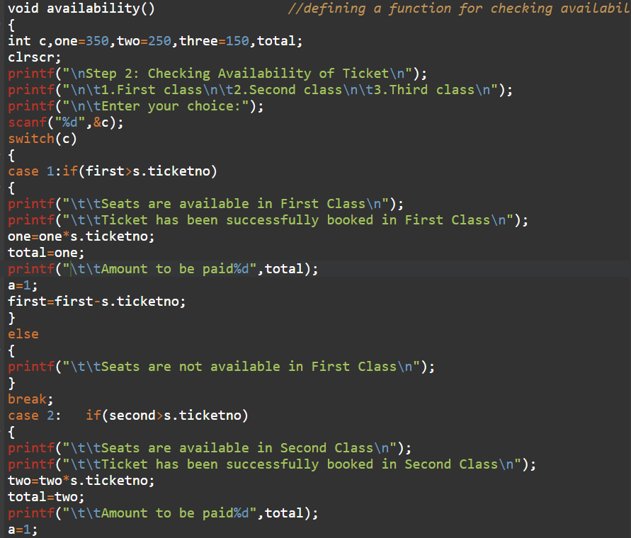

Slide 10
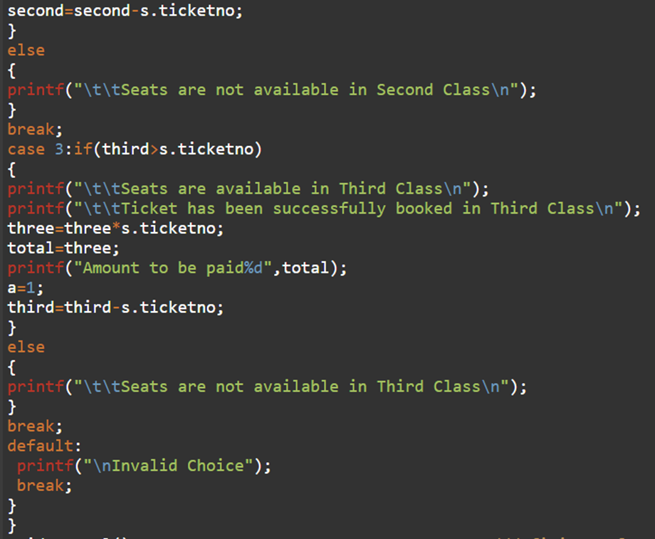

Slide 11
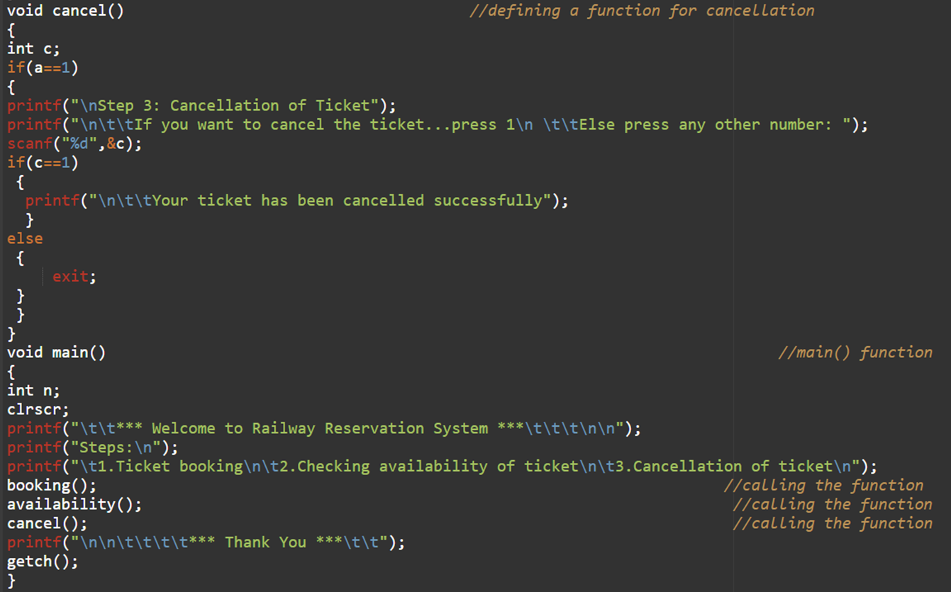

Slide 12
